Slide 1
Cybersecurity Frameworks
By: Anurag Tirumala, Sai Lu, Sime Weldegebrile, Bhargav Sabbineni, Jeremiah Warren, Lota Agulue​, Kaustuv Dutta

Slide 2
Company Background
Tech Tiger, Software and Application Development
Based in Singapore with 150 employees worldwide
Most developers are working virtually
Centralized on-premise server
All information – clients, employees, projects, etc.
Asynchronously backing up data into cloud
Multiple region and availability zones
Tech Tiger is handling diverse projects with clients around the world

Slide 3
What we will do:
Step 1
Provide a brief overview of three cybersecurity frameworks
Step 2
Provide similarities and differences between the three frameworks
Step 3
Provide a recommendation to Tech Tiger to establish the cybersecurity framework

Slide 4
NIST Framework
Publishes government-grade general cybersecurity guidelines.
Control baselines NIST 800 5B REV 5 (Sept 2020)
5 Defensive security categories with 20 controls families
More suitable for US federal and manufacturing

Slide 5
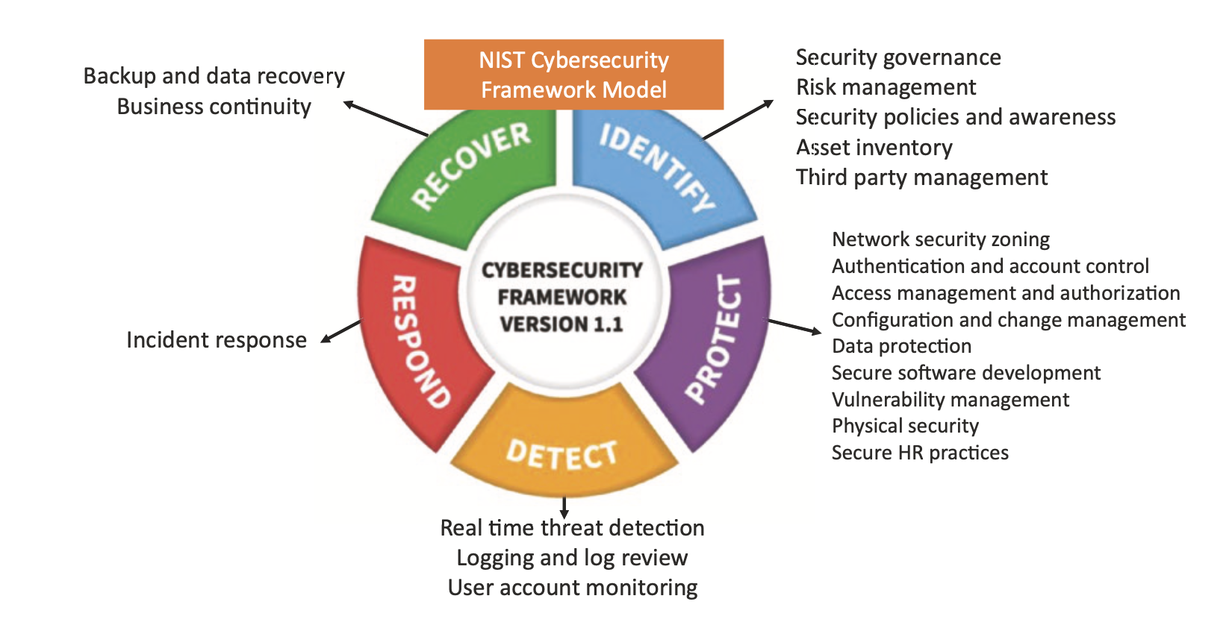
NIST Framework Continued

Slide 6
Center for Internet Security (CIS) Framework
Presents specific benchmarks around technology vendors and specific software systems
Control base
3 main categories (IG1-3) with 18 sub function with 153 safeguards
Suitable for Infrastructure and Software organization
Can be mapped to NIST 800-53
New alignment to the different cloud service models

Slide 7
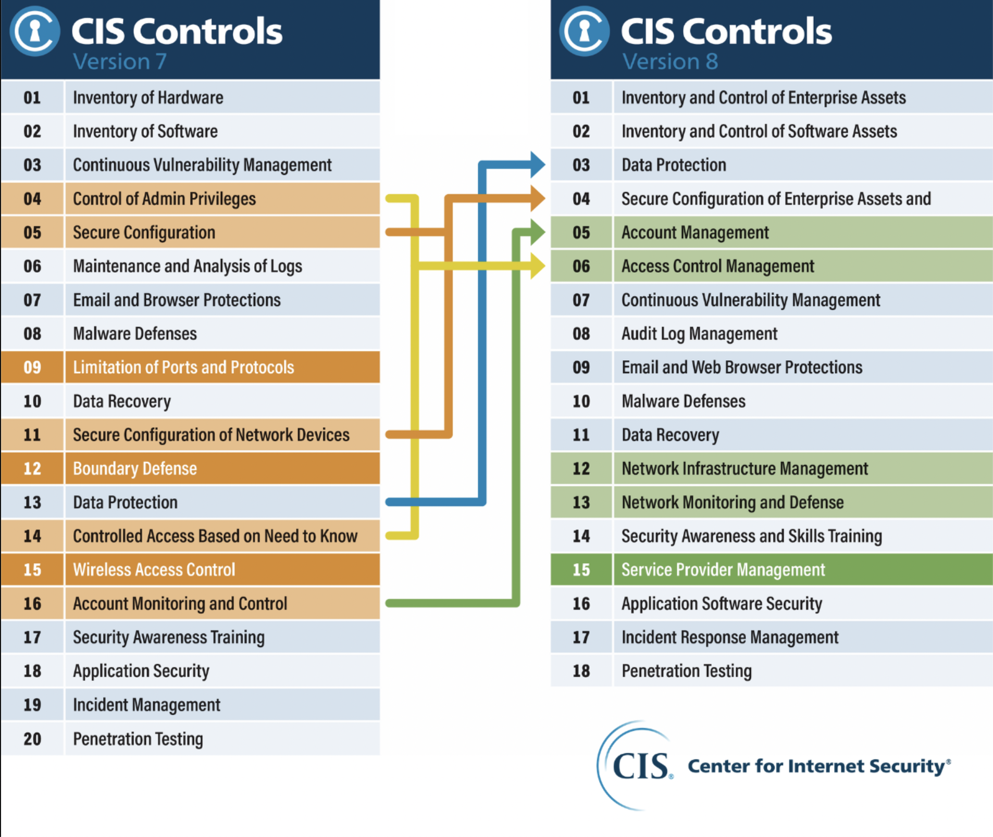
CIS from Version 7 to 8

Slide 8
Cloud Security Alliance (CSA) Framework
Oversees recommendations on cloud security assurances and compliances
CCM V.4.0.6 17 domains with 197 controls (Previous version 4.0 has 14 domains)
Can be mapped to CIS 18
Other benefits to CSA
• STAR Level 1: Security Questionnaire (CAIQ v4)
• Implementation Guidelines
• Auditing Guidelines

Slide 9
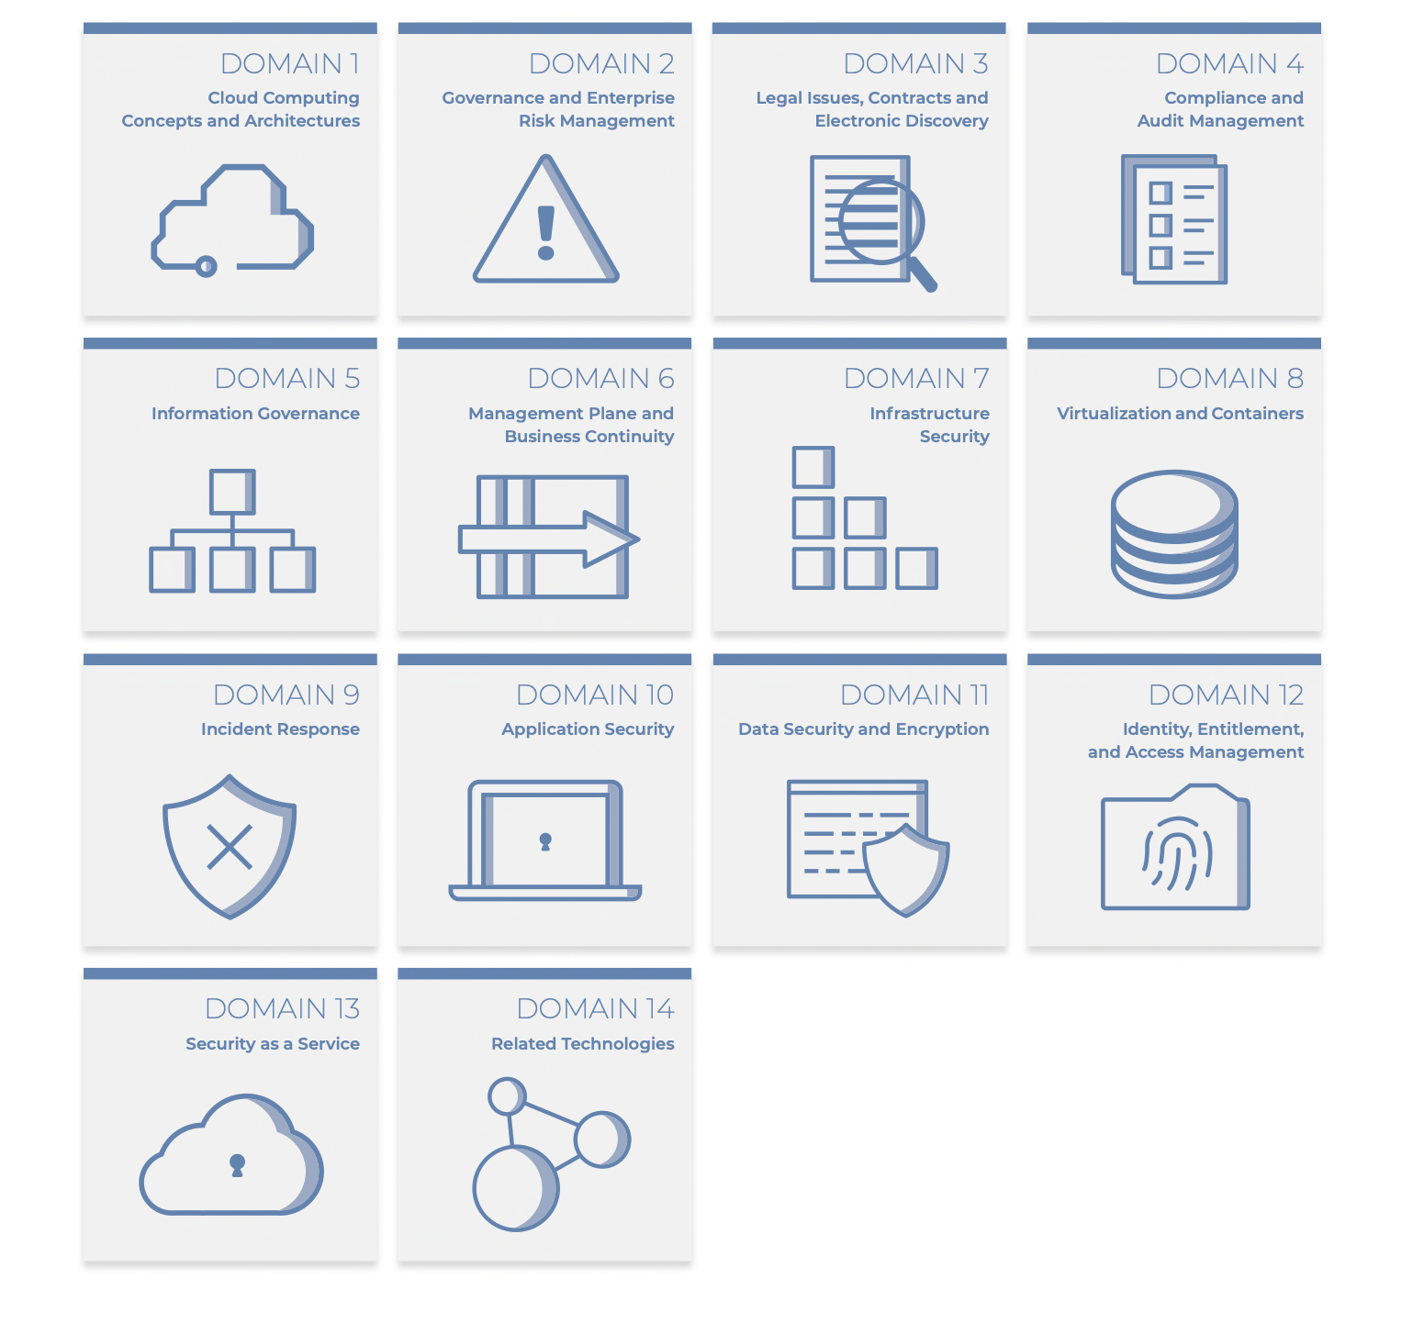
CCM V 4.0

Slide 10
Some Differences/Similarities
Key Features | NIST | CIS | CSA
Approach | Control based | Control based | Control based
Principle | Control Families | Control families | Domain dependent
Functions | 5 | 3 | 17 security domains
Certification | NO | NO | YEs
Best suited for | US Federal/ Manufacturing | Infrastructure and Software organization | Cloud based Organizations
Shared Responsibility | Can’t deal with shared responsibility | Can deal with shared responsibility | Can deal with shared responsibility
RBAC Complication | YES | NO | NO

Slide 11
Recommendations
CIS Framework is chosen for Tech Tiger for the following reasons:
Suitable for private software and application development company
Centralized in-house infrastructure with some cloud-base server
Can be mapped with NIST 800 – 53B and align with cloud
CIS is more prescriptive, and thus easier to understand and implement

Slide 12
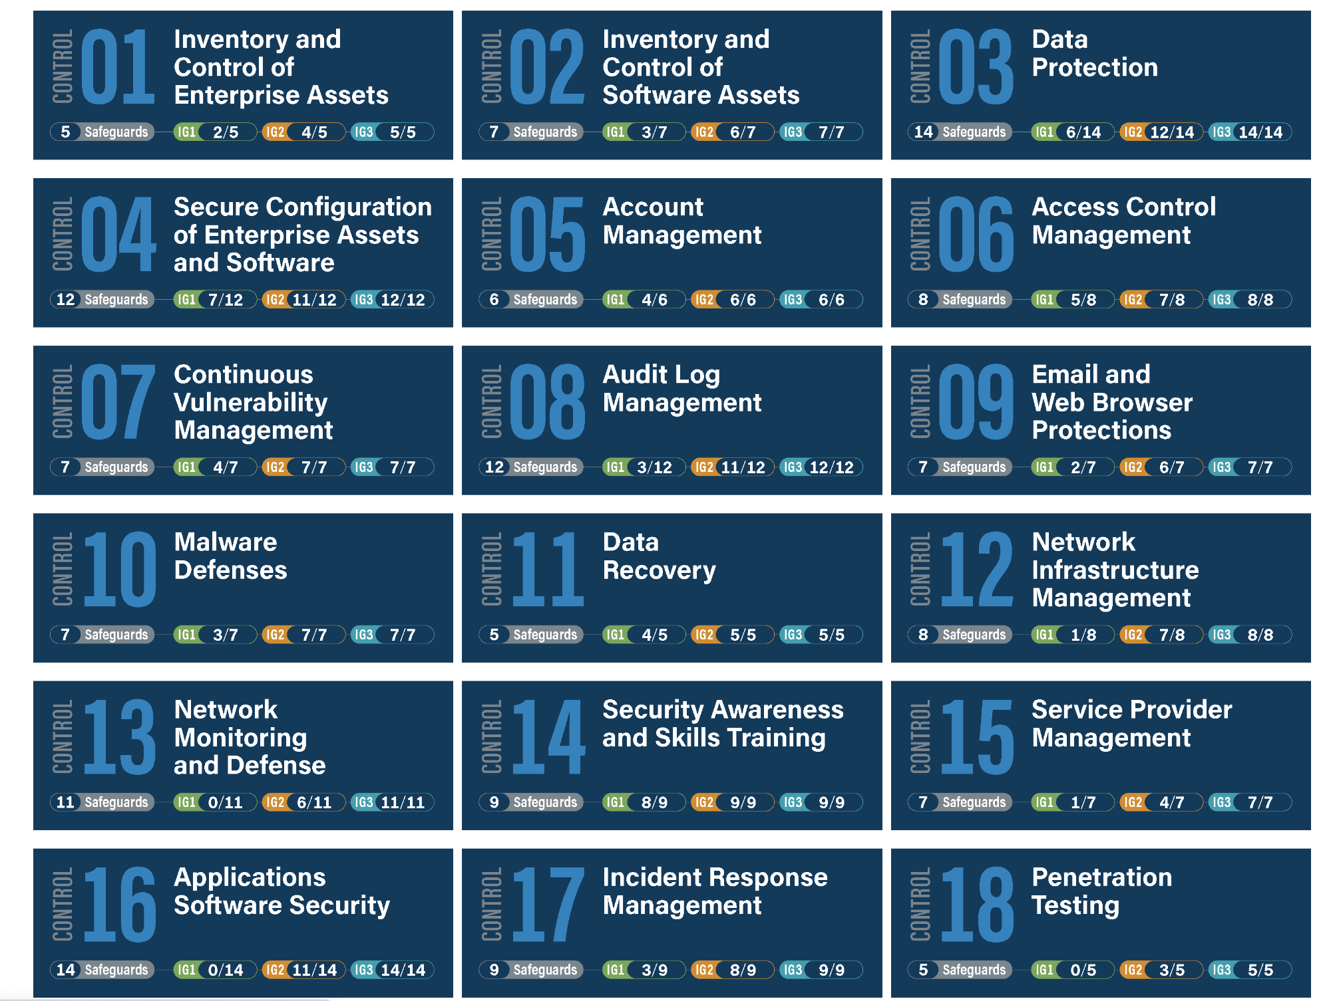
CIS Controls

Slide 13
Recommendations
Center for Internet Security (CIS) Framework
1. Inventory and Control of Enterprise Assets
Establishes and maintain an accurate, detailed, and up-to-date inventory of all enterprise assets with the potential to store or process data, to include end-user devices (including portable and mobile), network devices, non-computing/IoT devices, and servers.
Ensure the inventory records the network address (if static), hardware address, machine name, enterprise asset owner, department for each asset, and whether the asset has been approved to connect to the network. For mobile end-user devices, MDM type tools can support this process, where appropriate.
This inventory includes assets connected to the infrastructure physically, virtually, remotely, and those within cloud environments.
Additionally, it includes assets that are regularly connected to the enterprise’s network infrastructure, even if they are not under control of the enterprise. Review and update the inventory of all enterprise assets bi-annually, or more frequently. Utilize an active discovery tool to identify assets connected to the enterprise’s network. Configure the active discovery tool to execute daily, or more frequently

Slide 14
Recommendations
2.Inventory and Control of Software Assets
Use technical controls, such as application allowlisting, to ensure that only authorized software can execute or be accessed. Reassess bi-annually, or more frequently. Use technical controls, such as digital signatures and version control, to ensure that only authorized scripts, such as specific .ps1, .py, etc., files, are allowed to execute. Block unauthorized scripts from executing. Reassess bi-annually, or more frequently .
3.Data Protection
Configure data access control lists based on a user’s need to know. Apply data access control lists, also known as access permissions, to local and remote file systems, databases, and applications. Establish and Maintain a Data Classification Scheme :Establish and maintain an overall data classification scheme for the enterprise. Enterprises may use labels, such as “Sensitive,” “Confidential,” and “Public,” and classify their data according to those labels. Review and update the classification scheme annually, or when significant enterprise changes occur that could impact this Safeguard.

Slide 15
Recommendations
4. Secure Configuration of Enterprise Assets and Software
Configure automatic session locking on enterprise assets after a defined period of inactivity. For general purpose operating systems, the period must not exceed 15 minutes. For mobile end-user devices, the period must not exceed 2 minutes.
Configure data access control lists based on a user’s need to know. Apply data access control lists, also known as access permissions, to local and remote file systems, databases, and applications.
Implement and manage a firewall on servers, where supported. Example implementations include a virtual firewall, operating system firewall, or a third-party firewall agent.
Implement and manage a host-based firewall or port-filtering tool on end-user devices, with a default-deny rule that drops all traffic except those services and ports that are explicitly allowed.
DNS servers on enterprise assets. Example implementations include: configuring assets to use enterprise-controlled DNS servers and/or reputable externally accessible DNS servers.
Enforce automatic device lockout following a predetermined threshold of local failed authentication attempts on portable end-user devices, where supported. For laptops, do not allow more than 20 failed authentication attempts; for tablets and smartphones, no more than 10 failed authentication attempts. Example implementations include Microsoft® InTune Device Lock and Apple® Configuration Profile maxFailedAttempts.

Slide 16
Recommendations
5. Account Management
Use unique passwords for all enterprise assets. Best practice implementation includes, at a minimum, an 8-character password for accounts using MFA and a 14-character password for accounts not using MFA.
Restrict administrator privileges to dedicated administrator accounts on enterprise assets. Conduct general computing activities, such as internet browsing, email, and productivity suite use, from the user’s primary, non-privileged account.
Delete or disable any dormant accounts after a period of 45 days of inactivity, where supported
Centralize account management through a directory or identity service.

Slide 17
Recommendations
6. Access Control Management
Establish and follow a process, preferably automated, for granting access to enterprise assets upon new hire, rights grant, or role change of a user
Establish and maintain an inventory of the enterprise’s authentication and authorization systems, including those hosted on-site or at a remote service provider. Review and update the inventory, at a minimum, annually, or more frequently.
Require MFA for all administrative access accounts, where supported, on all enterprise assets, whether managed on-site or through a third-party provider.

Slide 18
Recommendations
7.Continuous Vulnerability Management
Perform operating system updates on enterprise assets through automated patch management on a monthly, or more frequent, basis.
Perform automated vulnerability scans of externally-exposed enterprise assets using a SCAP-compliant vulnerability scanning tool. Perform scans on a monthly, or more frequent, basis.
Remediate detected vulnerabilities in software through processes and tooling on a monthly, or more frequent, basis, based on the remediation process.

Slide 19
Recommendations
8.Audit Log Management
Collect audit logs. Ensure that logging, per the enterprise’s audit log management process, has been enabled across enterprise assets.
Standardize time synchronization. Configure at least two synchronized time sources across enterprise assets, where supported.
Collect URL request audit logs on enterprise assets, where appropriate and supported.

Slide 20
Recommendations
9.Email and Web Browser Protections
Use DNS filtering services on all enterprise assets to block access to known malicious domains through uninstalling or disabling, any unauthorized or unnecessary browser or email client plugins, extensions, and add-on applications.
To lower the chance of spoofed or modified emails from valid domains, implement DMARC policy and verification, starting with implementing the Sender Policy Framework (SPF) and the DomainKeys Identified Mail (DKIM) standards.
Deploy and maintain email server anti-malware protections, such as attachment scanning and/or sandboxing.

Slide 21
Recommendations
10. Malware Defenses
Disable autorun and Autoplay auto-execute functionality for removable media.
Centrally manage anti-malware software.
11. Data Recovery
Perform automated backups of in-scope enterprise assets. Run backups weekly, or more frequently, based on the sensitivity of the data.
Establish and maintain an isolated instance of recovery data. Example implementations include, version controlling backup destinations through offline, cloud, or off-site systems or services.

Slide 22
Recommendations
12.Network Infrastructure Management
Establish and maintain a secure network architecture. A secure network architecture must address segmentation, least privilege, and availability, at a minimum.
Centralize network AAA.
Establish and maintain dedicated computing resources, either physically or logically separated, for all administrative tasks or tasks requiring administrative access. The computing resources should be segmented from the enterprise's primary network and not be allowed internet access.

Slide 23
Recommendations
13. Network Monitoring and Defense
Perform traffic filtering between network segments, where appropriate.
Manage access control for assets remotely connecting to enterprise resources. Determine amount of access to enterprise resources based on: up-to-date anti-malware software installed, configuration compliance with the enterprise’s secure configuration process, and ensuring the operating system and applications are up-to-date.
Deploy an intrusion prevention solution, where appropriate. Example implementations include the use of a Network Intrusion Prevention System (NIPS) or equivalent CSP service.

Slide 24
Recommendations
14. Security Awareness and Skills Training
Establish and maintain a security awareness program. The purpose of a security awareness program is to educate the enterprise’s workforce on how to interact with enterprise assets and data in a secure manner. Conduct training at hire and, at a minimum, annually. Review and update content annually, or when significant enterprise changes occur that could impact this Safeguard.
Train workforce members to recognize social engineering attacks, such as phishing, pre-texting, and tailgating.
Train workforce to understand how to verify and report out-of-date software patches or any failures in automated processes and tools. Part of this training should include notifying IT personnel of any failures in automated processes and tools.
Conduct role-specific security awareness and skills training. Example implementations include secure system administration courses for IT professionals, (OWASP® Top 10 vulnerability awareness and prevention training for web application developers, and advanced social engineering awareness training for high-profile roles.

Slide 25
Recommendations
15. Service Provider Management
Classify service providers. Classification consideration may include one or more characteristics, such as data sensitivity, data volume, availability requirements, applicable regulations, inherent risk, and mitigated risk. Update and review classifications annually, or when significant enterprise changes occur that could impact this Safeguard.
Ensure service provider contracts include security requirements. Example requirements may include minimum security program requirements, security incident and/or data breach notification and response, data encryption requirements, and data disposal commitments. These security requirements must be consistent with the enterprise’s service provider management policy. Review service provider contracts annually to ensure contracts are not missing security requirements.
Monitor service providers consistent with the enterprise’s service provider management policy. Monitoring may include periodic reassessment of service provider compliance, monitoring service provider release notes, and dark web monitoring.

Slide 26
Recommendations
16. Application Software Security
Establish and maintain a secure application development process. In the process, address such items as: secure application design standards, secure coding practices, developer training, vulnerability management, security of third-party code, and application security testing procedures. Review and update documentation annually, or when significant enterprise changes occur that could impact this Safeguard.
Perform root cause analysis on security vulnerabilities. When reviewing vulnerabilities, root cause analysis is the task of evaluating underlying issues that create vulnerabilities in code and allows development teams to move beyond just fixing individual vulnerabilities as they arise.
Conduct threat modeling. Threat modeling is the process of identifying and addressing application security design flaws within a design, before code is created. It is conducted through specially trained individuals who evaluate the application design and gauge security risks for each entry point and access level. The goal is to map out the application, architecture, and infrastructure in a structured way to understand its weaknesses.

Slide 27
Recommendations
17. Incident Response Management
Designate one key person, and at least one backup, who will manage the enterprise’s incident handling process. Management personnel are responsible for the coordination and documentation of incident response and recovery efforts and can consist of employees internal to the enterprise, third-party vendors, or a hybrid approach. If using a third-party vendor, designate at least one person internal to the enterprise to oversee any third-party work. Review annually, or when significant enterprise changes occur that could impact this Safeguard.
Assign key roles and responsibilities for incident response, including staff from legal, IT, information security, facilities, public relations, human resources, incident responders, and analysts, as applicable. Review annually, or when significant enterprise changes occur that could impact this Safeguard.
Plan and conduct routine incident response exercises and scenarios for key personnel involved in the incident response process to prepare for responding to real-world incidents. Exercises need to test communication channels, decision making, and workflows. Conduct testing on an annual basis, at a minimum

Slide 28
Recommendations
18. Penetration Testing
Validate security measures after each penetration test. If deemed necessary, modify rulesets and capabilities to detect the techniques used during testing.
Perform periodic internal penetration tests based on program requirements, no less than annually. The testing may be clear box or opaque box

Slide 29
References
https://www.sans.org/blog/cis-controls-v8/
https://www.nist.gov/cyberframework
https://www.cisecurity.org/controls/cis-controls-list
https://www.apptega.com/blog/nist-csf-and-cis-v8-commonalities-differences

